Slide 1



kickstarter Presentation
View in Power BI
Last data refresh:
7/22/2022 12:50:57 AM UTC
Downloaded at:
8/7/2022 5:46:32 PM UTC

Slide 2
Introduction What is Kickstarter?
Kickstarter is a company that brings different creative projects and organizes online pledging campaign to financially support these projects.
The purpose of Kickstarter is to bring those well funded creative projects to reality.
Anyone who pledges a specific amount of money for the projects are called the backers of Kickstarter.
The project campaign success is determined if and only the amount of money pledged for the project meet 100 % or more of the funding goal.

Slide 3
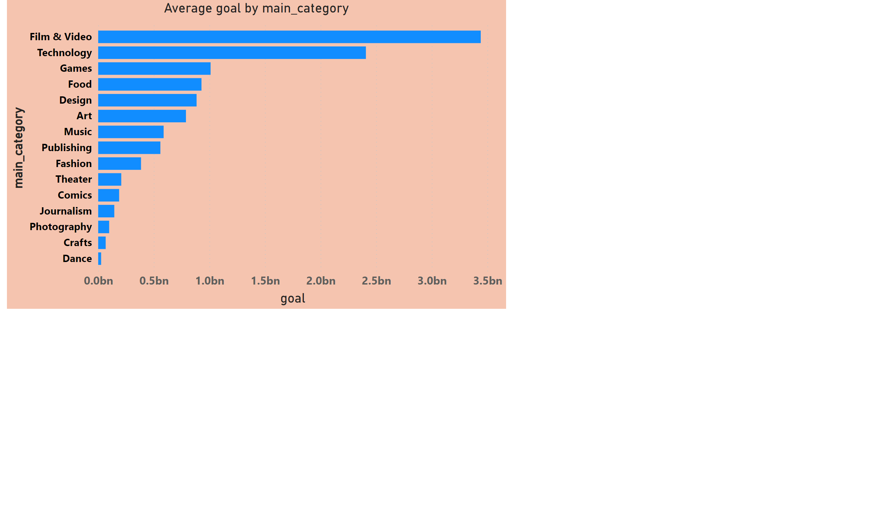

Page 2
Notes:
Average goal by main_category
No alt text provided

Slide 4
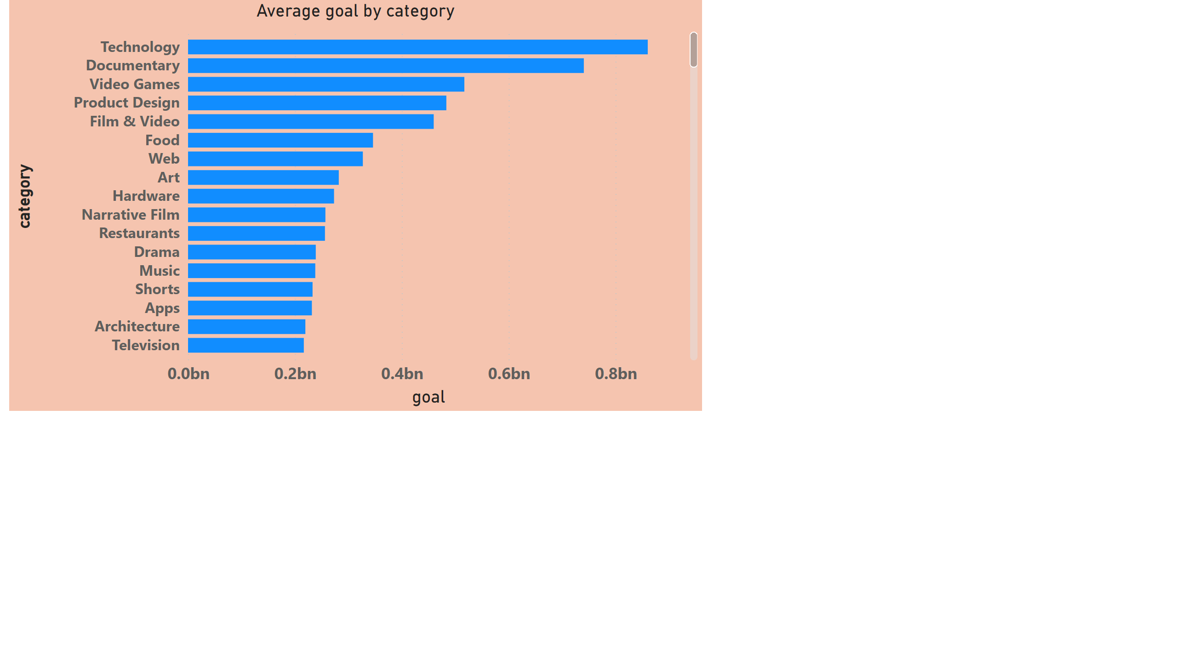
Page 3
Notes:
Average goal by category
No alt text provided

Slide 5
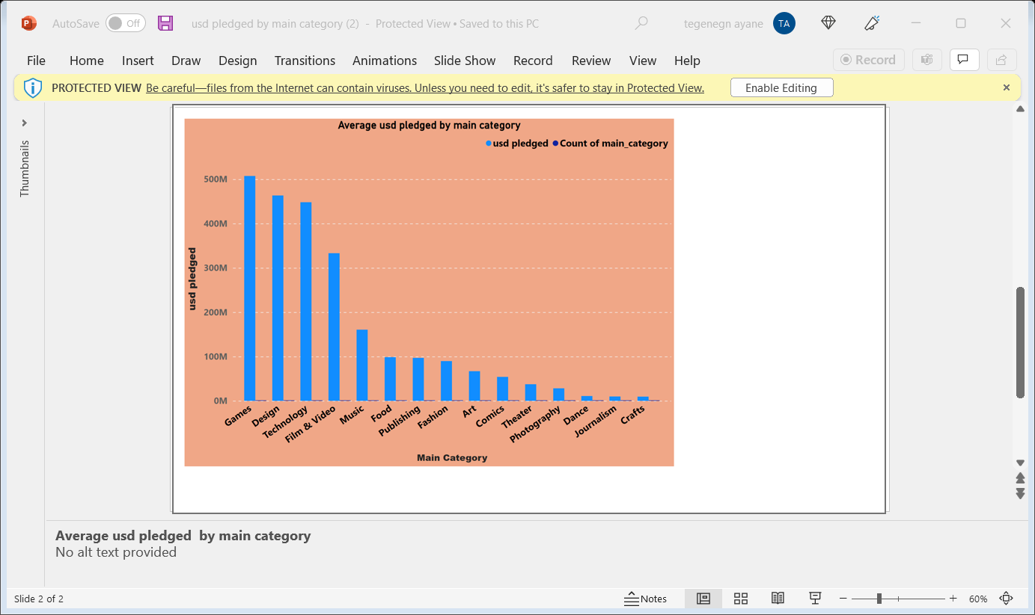

Slide 6
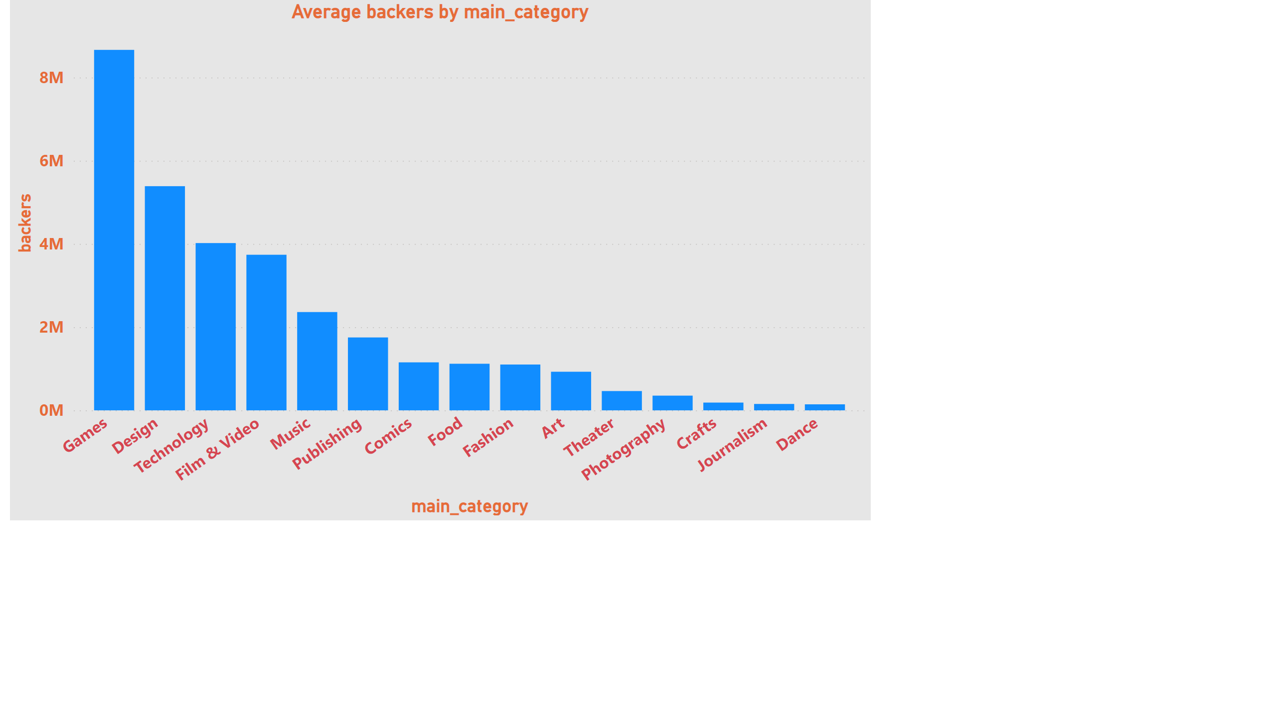
Page 4
Notes:
Average backers by main_category
No alt text provided

Slide 7
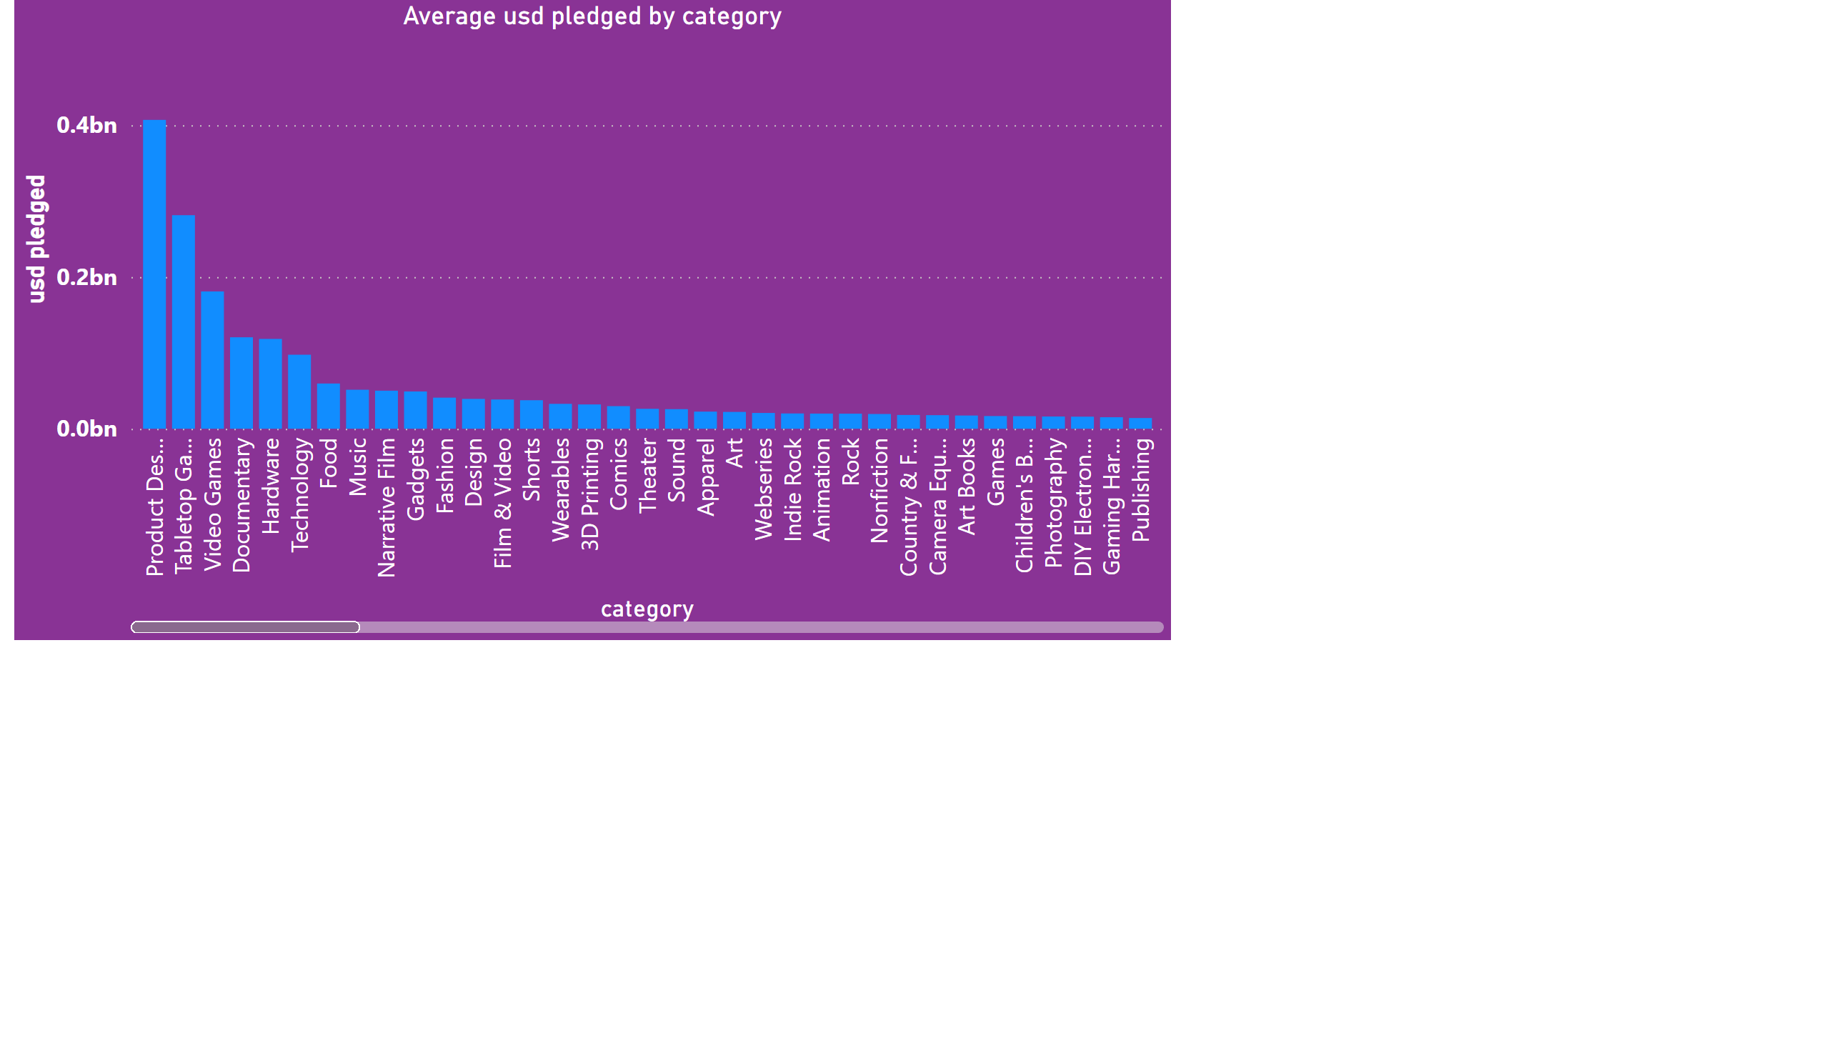
Page 6
Notes:
Average usd pledged by category
No alt text provided

Slide 8
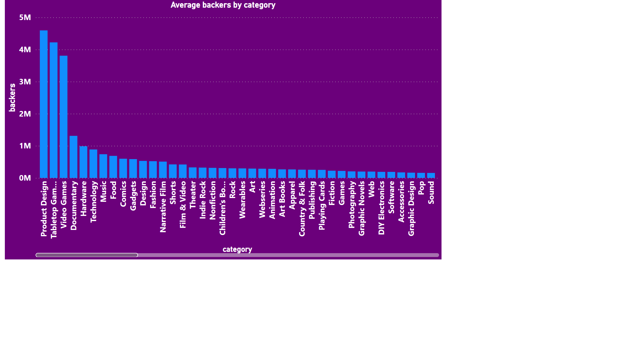
Page 5
Notes:
Average backers by category
No alt text provided

Slide 9
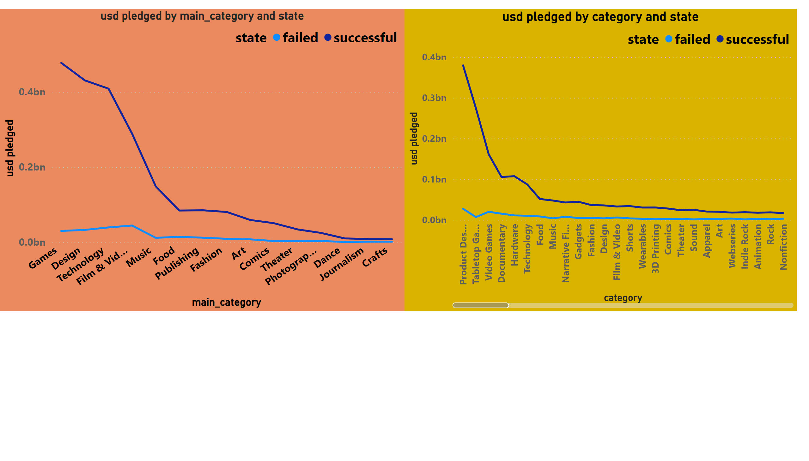
Page 8
Notes:
lineChart
No alt text provided
lineChart
No alt text provided

Slide 10
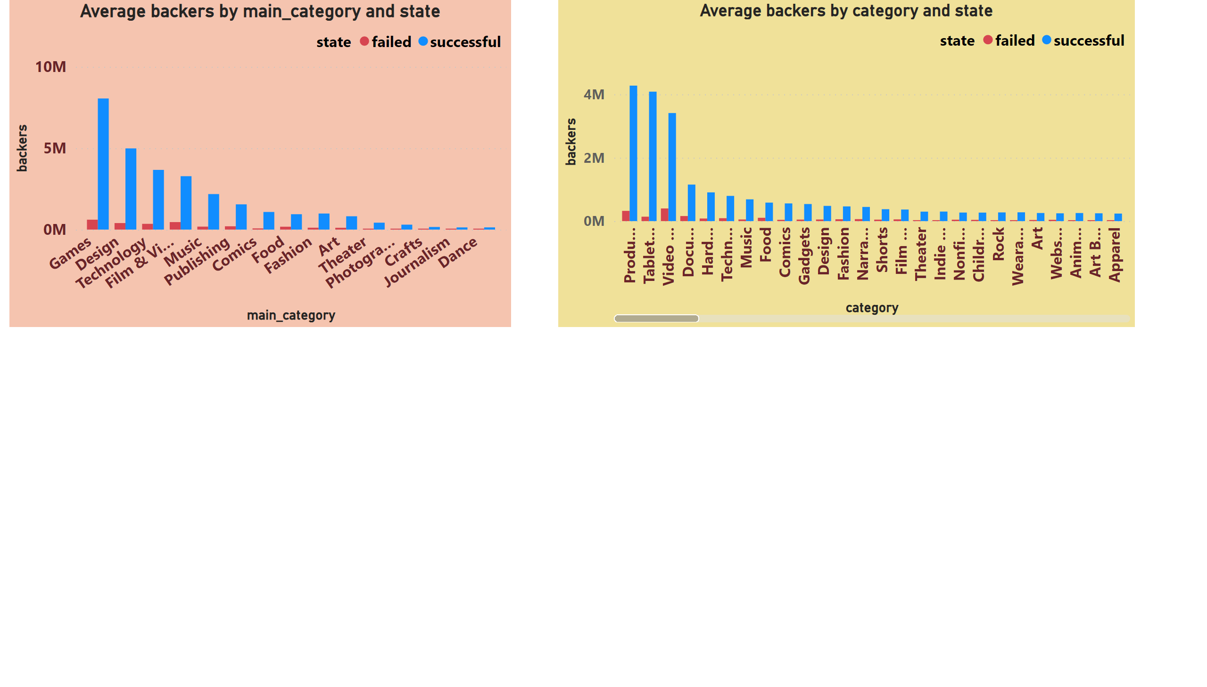
Page 9
Notes:
Average backers by main_category and state
No alt text provided
Average backers by category and state
No alt text provided

Slide 11
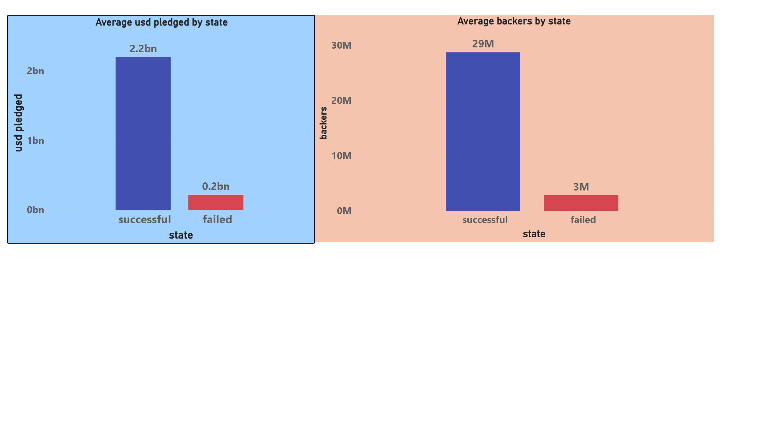
Page 7
Notes:
Average usd pledged by state
No alt text provided
Average backers by state
No alt text provided

Slide 12
Conclusion
What kinds of projects should the Kickstarter Marketing Team focus their attention on? Why?
Main category
design
games
technology
Category
Product design
tabletop games
Video games
These projects have attracted highest usd pledged and backers

Slide 13
Thank you

